Slide 1

ME algorithm
for Hierarchical Dirichlet Process
and extensions
Donglai Wei
Supervised by: Erik Sudderth

Slide 2
Part I: Model

Slide 3

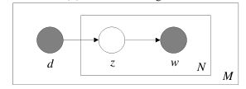
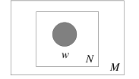
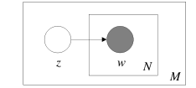
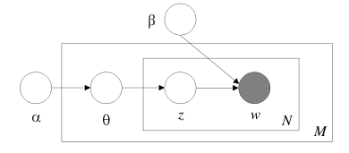
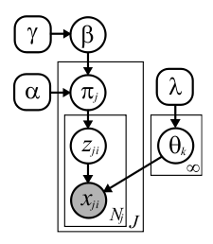
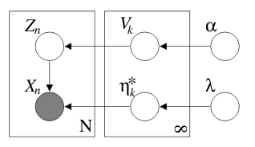

Evolution of the Model:
1)Unigram
2)Mixture of Unigram
3)Aspect Model
4) LDA
7) HPY (stick-breaking)
6) HDP (stick-breaking)
5) DP mixture(stick-breaking)

Slide 4
Part II: Algorithm

Slide 5

What is ME algorithm?
ME~EM?

Slide 6
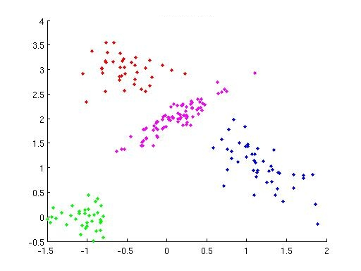
Cluster Problem:
Mixture of Gaussian:
X: observations
Z: cluster label
θ:(μ,Σ)
Kmean:
0) Initialization
1)M-step(Z):
Assign points to their nearest center
2)M-step(θ):
MLE estimator for (μ,Σ)
EM:
0) Initialization
1)E-step(Z):
p(z=k|x)~p(x|z=k)p(z=k)
2)M-step(θ):
MLE estimator for (μ,Σ,p(z))

Slide 7
Learning Algorithms based on KL divergence:
Probabilistic Model:
1) Observation (x)
2) Hidden Variable(w): z(assignment), θ(parameter)
3) Hyperparameter(λ)
Goal: Learn q(W)
1) MLE:
2) KL Divergence(lower bound):

Slide 8

Goal:
min
? q(z,θ)
Gibbs Sampling
q(z,θ)=q(z)q(θ)
Distribution Estimation:
Point Estimation:

Slide 9

Expectation Expectation
(EE)
Maximization Expectation
(ME)
(Kurihara et.al)
Gibbs Sampling
(GS)
Expectation Maximization
(EM)
Maximization Maximization
(MM)
Mean Field (Variational Method):
0) Initialization
1)E-step(Z):
Assign points to their nearest center
2)E-step(θ):
MLE estimator for (μ,Σ)

Slide 10
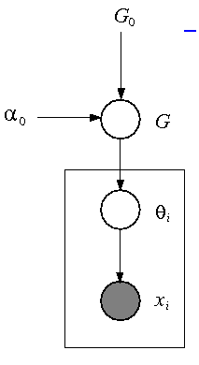
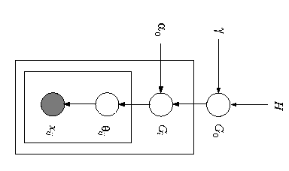
Infinite Limit of LDA
ME: Kurihara et.al
Stick-Breaking
GS: Ishwaran et.al,
EE: Blei et.al, Kurihara et.al
Chinese Restaurant Process
GS: Neal et.al
DP
HDP
We Are Here
!!!
Infinite Limit of LDA
Stick-Breaking
EE:Teh et.al
Chinese Restaurant Franchise
GS Teh et.al,
ME:

Slide 11
Why ME algorithm?
What do we really want for Clustering Problems?

Slide 12
Give Me the “BEST” Z !!!
1) Approximate the distribution of z:
q(z)-> assignment z
2) Find z that maximizes the marginal probability

Slide 13

Why not EE algorithm?

Slide 14

Why not Gibbs Sampling?

Slide 15
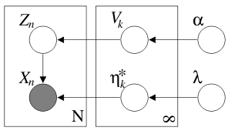
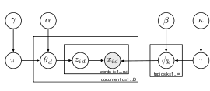
DPmixture:
Blei et.al
HDP:
Teh et.al

Slide 16

ME: search z to minimize F(z,K)
Update:
Problem: Generative!
M-step:
E-step:
Local Search: the assignment of ith data @ t+1 th iteration
Hierarchical: the assignment of ith cluster @ t+1 th iteration

